Slide 1
Name of the project -
Role Of the document -
Submited By :-
Kanhu charan Das
Neha Kathar
Pritam Patel

Slide 2
Quality Assurance Statement :-
The quality of a product (article or service) is its ability to satisfy the
needs and exception of the Customer.
Quality is today an important factor to consider if a company wants compile in the world
market .If we not continuously improving quality in an organization it is likely market share will be lost to competitors that is more aware of the importance of Quality.
Quality Management
Quality Assurance
Quality Planning
Quality Control
Quality Improvement

Slide 3
Quality Assurance :-
Quality Assurance is the concern of every software engineer to reduce cost and
improve product time-to-market.
Software Quality Assurance activities are performed on every software project , Use of metrics is
an important part of developing a strategy to improve the quality of both software processes and work products.
Quality Planning :-
Quality planning is the method of deciding what’s most important to the project.
This occurs during the planning stage, where you determine the critical factors for a successful project. This includes the resources needed to deliver the project, what steps to take and specifications that have to be met.
The quality plan itself includes : Objectives ,Processes ,Roles and responsibilities ,Applied standards, Metrics to measure quality.

Slide 4
Quality Control :-
The overall system of activities, the purpose of which is to provide a quality product or service that meets the need of the users. The aim of quality control is to provide quality that is satisfactory, adequate, dependable, and economic.
Quality control can be interpreted as a method and operational mobilization used to achieve the desired quality standards.
Quality Improvement :-
The quality of software products can be improved through an iterative process of
continuous improvement which requires management control, coordination, and feedback from many concurrent processes: the software life cycle processes; the process of error/defect detection, removal, and prevention; and the quality improvement process.
It is a recurring theme in all quality management literature and international standards including
ISO 9001 (refer clause 0.2 Process approach). The core principle is that quality improvement is not a
one-time effort; it is an ongoing process that lasts for the life of an enterprise.

Slide 5
Quality Assurance Evaluation :-
Review the Code :-
Code review is a software quality assurance activity in which one or several people check a program mainly by viewing and reading parts of its source code, and they do so after implementation or as an interruption of implementation.
In our Project Code Review is Done in Github and Push the Code in github and review the Entire Code .
Software Reviews process -
Planning
Error Correction
Individual Preparation
Review
Meeting
Follow-up Checks
Group preparation
Improvement
Pre-review activities Post-review activities

Slide 6
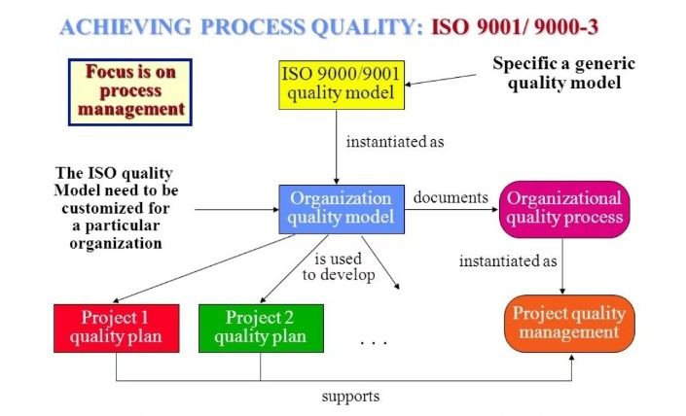
Review the Code ISO 9001/9000-3 Standard :-
The ISO 9000 family is the world’s best-known quality management standard for companies
and organization of any size.
ISO 9000 specifies actions to be taken when any system (not necessarily a software system) has quality goals and constraints.
It specifies generic procedures that should be in place to have a quality process.
Our software development has some unique factors that affect its quality :
- software is designed, not manufactured
- software development is creative, not mechanical
- Individual skills and experience have a significant influence
- External factors (application novelty, commercial pressure)
- It is possible for a level 1 organization to receive ISO 9000
certification.
A)Quality System Framework :-
1. Management Responsibility
2. Quality System
3. Internal Quality System audits
4. Corrective auction
B)Quality Life Cycle Activities :-
1. Contract review
2. Purchaser’s requirements specifications
3. Development Planning
4. Quality Record

Slide 7
5. Design and Implementation
6. Testing and Validation
7. Acceptance
8. Replication ,delivery and Installation
9. Maintenance
Coding CMM Level:-
It is a framework that is used to analyze the approach and techniques followed by any organization to develop software products.
It also provides guidelines to further enhance the maturity of the process used to develop those software products.
Key Processes in Place :
Level 1: Initial process
Level 2: Repeatable process
Requirements Management
Software Project Tracking & Oversight
Software Subcontract Management
Software Project Planning
Software Quality Assurance
Software Configuration Management

Slide 8
Level 3: Defined process
Organization Process Focus
Organization Process Definition
Training Program
Integrated Software Management
Software Product Engineering
Intergroup Coordination
Peer Reviews
Level 4: Managed process
Quantitative Process Management
Software Quality Management
Level 5: Optimizing process
Fault Prevention
Technology Change Management
Process Change Management

